Slide 1
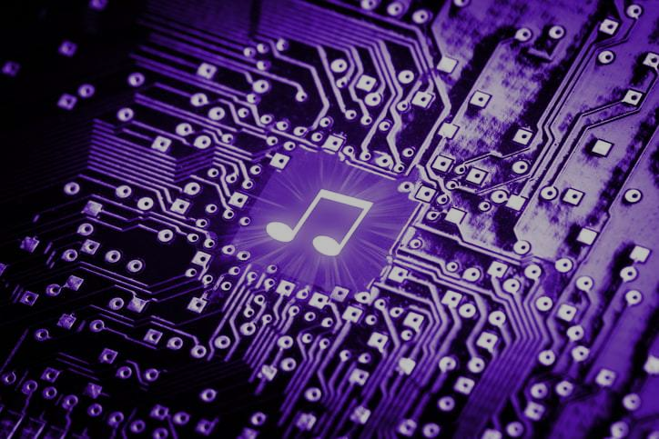
Decentralized Platform for Interactive Music Performance and Composition
Leveraging the Power of HPC and Distributed Parallel Systems
Team No. 28
ID: 20101477
Name: Md. Sifat Mahmud
ST name: Farah and Sania

Slide 2

Background and Motivation
The digital music landscape is evolving rapidly, with increasing demand for online collaboration and interactive experiences.
Existing centralized platforms face limitations in scalability, user control, and transparency.
A decentralized platform empowered by blockchain technology and distributed parallel systems holds significant promise for addressing these limitations and revolutionizing music creation and performance.

Slide 3
Research Objectives
Design and implement a decentralized platform for interactive music performance and composition.
Leverage HPC for real-time audio processing and AI-powered music generation.
Develop a robust and secure architecture utilizing blockchain technology.
Foster a vibrant community of users and ensure fair compensation for creators.

Slide 4

Key Research Directions
The Digital Decentralized Architecture:
Blockchain-based infrastructure for user management, content sharing, and governance.
Distributed network for efficient data storage, processing, and communication.
Real-time audio streaming and synchronization protocols.
High-Performance Audio Processing:
Spatial audio rendering and mixing for immersive experiences.
Low-latency audio processing for interactive performance.
Feedback management and optimization for seamless collaboration.
AI-powered Music Generation:
Algorithmic composition and improvisation tools for individual and collaborative creativity.
Personalized musical accompaniment and dynamic elements for enhanced expressiveness.
Seamless integration with human musicians for hybrid performance experiences.
Decentralized Governance:
Blockchain-based voting and consensus mechanisms for transparent decision-making.
Fair compensation models for musicians and creators based on their contributions.
Community-driven governance processes and dispute resolution mechanisms.

Slide 5
Potential Benefits
Democratization of Music Creation: Enables musicians of all skill levels and backgrounds to participate in collaborative music creation and performance regardless of location.
New Frontiers of Musical Expression: Facilitates innovative and interactive music experiences beyond the limitations of traditional platforms.
Fair Compensation for Creators: Blockchain-based mechanisms ensure transparent and fair distribution of revenue among musicians and creators.
Scalability and Resilience: Distributed systems architecture allows the platform to accommodate a large number of users and ensure stability and performance.

Slide 6
Related Research
On the Development and Practice of AI Technology for Contemporary Popular Music Production: Provides valuable insights into the application of AI music technologies in music production.
Usage of Deep Learning and Blockchain in Compilation and Copyright Protection of Digital Music: Demonstrates the potential of blockchain technology for secure content management and copyright protection.
Research on distributed systems and blockchain technology in other fields: Provides valuable knowledge and best practices for building secure and scalable distributed platforms.
Existing decentralized music platforms: Offers valuable lessons learned and identifies areas for improvement.
References
Deruty, E., Grachten, M., Lattner, S., Nistal, J., & Aouameur, C. (2022, February 7). On the Development and Practice of AI Technology for Contemporary Popular Music Production. Transactions of the International Society for Music Information Retrieval.
https://doi.org/10.5334/tismir.100
Usage of Deep Learning and Blockchain in Compilation and Copyright Protection of Digital Music. (2020). IEEE Journals & Magazine | IEEE Xplore.
https://ieeexplore.ieee.org/document/9186017?denied=

Slide 7

Challenges and Future Research
Technical Implementation
Security and Privacy
Governance and Community Building
Integration with Existing Music Ecosystems
Ethical Considerations

Slide 8
Planned Research Activities
Democratization of Music Creation: Enables musicians of all skill levels and backgrounds to participate in collaborative music creation and performance regardless of location.
New Frontiers of Musical Expression: Facilitates innovative and interactive music experiences beyond the limitations of traditional platforms.
Fair Compensation for Creators: Blockchain-based mechanisms ensure transparent and fair distribution of revenue among musicians and creators.
Scalability and Resilience: Distributed systems architecture allows the platform to accommodate a large number of users and ensure stability and performance.

Slide 9
Conclusion
Building a decentralized platform for interactive music performance and composition offers a unique opportunity to revolutionize the music industry.
By leveraging HPC and distributed parallel systems, this research has the potential to empower musicians, foster collaboration, and create new frontiers of musical expression.
This research will contribute significantly to the advancement of music technology and pave the way for a more inclusive and equitable future for music creation and performance.

Slide 10

Thank You

